Slide 1
Data Communications for a Global Environment
Lecture 9

Slide 2
MAC Address Resolution
Data Communications for a Global Environment
Problem:
Unknown MAC address of the next node (whose IP address known)
Solution:
Uses Address Resolution Protocol (ARP)
Operation
Broadcast an ARP message to all nodes on a LAN asking which node has a certain IP address
Host with that IP address then responds by sending back its MAC address
Store this MAC address in its address table
Send the message to the destination node
Example of a MAC address: 00-0C-00-F5-03-5A

Slide 3
Routing
Data Communications for a Global Environment
Process of identifying what path to have a packet take through a network from sender to receiver
Routing Tables
Used to make routing decisions
Shows which path to send packets on to reach a given destination
Kept by computers making routing decisions
Routers
Special purpose devices used to handle routing decisions on the Internet
Maintain their own routing tables

Slide 4
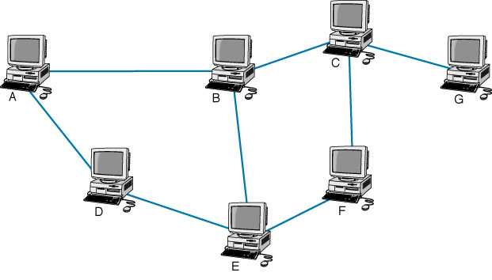
Routing Example
Data Communications for a Global Environment
Possible paths from A to G:
ABCG
ABEFCG
ADEFCG
ADEBCG
A
B
Routing Table for A
Dest.
B
C
D
E
F
G
Next
B
B
D
D
D
B
Each node has its own routing table

Slide 5
Types of Routing
Data Communications for a Global Environment
Centralized routing
Decisions made by one central computer
Used on small, mainframe-based networks
Decentralized routing
Decisions made by each node independently of one another
Information need to be exchanged to prepare routing tables
Used by Internet

Slide 6
Types of Decentralized Routing
Data Communications for a Global Environment
Static routing:
Uses fixed routing tables developed by network managers
Each node has its own routing table
Changes when computers added or removed
Used on relatively simple networks with few routing options that rarely change
Dynamic routing or Adaptive routing:
Uses routing tables at each node that are updated dynamically
Based on routing condition information exchanged between routing devices

Slide 7
How would you decide best path?
Data Communications for a Global Environment

Slide 8
Dynamic Routing Algorithms
Data Communications for a Global Environment
A
C
B
G
Distance Vector
Uses the least number of hops to decide how to
route a packet
Used by Routing Information Protocol (RIP)
Link State
Uses a variety of information types to decide how to route a packet (more sophisticated)
e.g., number of hops, congestion, speed of circuit
Links state info exchanged periodically by each node to keep every node in the network up to date
Provides more reliable, up to date paths to destinations
Used by Open Shortest Path First (OSPF) protocol
D
F
E
Ex: From A to G → ABCG

Slide 9
Routing Protocols
Used to exchange info among nodes for building and maintaining routing tables
Autonomous System (AS)
A network operated by an organization (e.g., Indiana U.)
Protocols classified based on autonomous systems
Types of Routing Protocols
Interior routing protocols (RIP, OSPF, EIGRP, ICMP)
Operate within a network (autonomous system)
Provide detailed info about each node and paths
Exterior routing protocols (BGP)
Operate between networks (autonomous systems)

Slide 10
Routing Information Protocol (RIP)
A dynamic distance vector interior routing protocol
Once popular on Internet; now used on simple networks
Operations:
Manager builds a routing table by using RIP
Routing tables broadcast periodically (every minute or so) by all nodes
When a new node added, RIP counts number of hops between computers and updates routing tables

Slide 11
Open Shortest Path First (OSPF)
A dynamic link state interior routing protocol
Became more popular on Internet
More reliable paths
Incorporates traffic and error rate measures
Less burdensome to the network
Only the updates sent (not entire routing tables) and only to other routers (no broadcasting)

Slide 12
Other Interior Routing Protocols
Enhanced Interior Gateway Routing Protocol (EIGRP)
A dynamic link state protocol (developed by Cisco)
Records transmission capacity, delay time, reliability and load for all paths
Keeps the routing tables for its neighbors and uses this information in its routing decisions as well
Internet Control Message Protocol (ICMP)
Simplest and most basic
An error reporting protocol (report routing errors to message senders)
Limited ability to update routing tables

Slide 13
Exterior Routing Protocols
Border Gateway Protocol (BGP)
Used to exchange routing info between autonomous systems
Based on a dynamic distance vector algorithm
Far more complex than interior routing protocols
Provide routing info only on selected routes (e.g., preferred or best route)
Privacy concern
Too many routes; can’t maintain tables of every single route

Slide 14
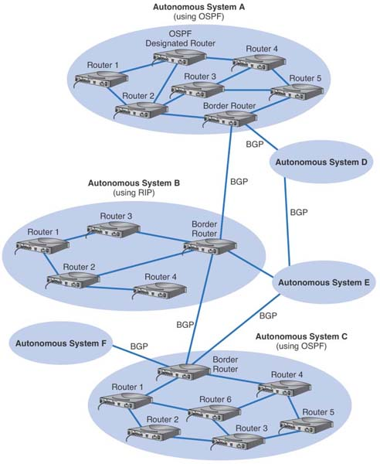
Internet Routing
using
BGP, OSPF and
RIP

